Slide 1
How 21st Century Students Use Technology
A Quick Primer for Parents Thom Barclay C. Joshua Villines
galloway.villines.com

Slide 2
The Dangers of Technology
“… you will give your students not truth but only the semblance of truth: they will be hearers of many things and will have learned nothing; they will appear to be omniscient and will generally know nothing: they will be tiresome company, having the show of wisdom without the reality.”
- Socrates, in Plato’s Phaedrus, speaking about writing

Slide 3
More from Phaedrus
“For this invention will produce forgetfulness in the minds of those who learn to use it, because they will not practice their memory. Their trust in writing, produced by external characters which are no part of themselves, will discourage the use of their own memory within them. You have invented an elixir not of memory, but of reminding; and you offer your pupils the appearance of wisdom, not true wisdom.” Cited in: Gleick, James (2011-03-01). The Information: A History, a Theory, a Flood. Random House, Inc. (Kindle Edition), p. 30.
“I cannot help feeling, Phaedrus, [says Socrates] that writing is unfortunately like painting; for the creations of the painter have the attitude of life, and yet if you ask them a question they preserve a solemn silence.… You would imagine that they had intelligence, but if you want to know anything and put a question to one of them, the speaker always gives one unvarying answer.” Ibid., p. 47

Slide 4
Today’s Topics
Students’ Hierarchy of Communication
The Nature of 21st Century Communication
How Technology Has Changed in the Past Five Years
Quick Introduction to the Most Commonly-Used Sites
Pedagogy and Play
Questions

Slide 5
A Hierarchy of Communication
How do I get in touch with my friend?
Facebook Chat
Skype
Text Message
Steam Chat
Try Someone Else
If there is no other way…
Facebook Message
First Class Message
E-mail

Slide 6
Changes in Communication
Not a Better/Worse comparison, just Different
People will always find ways to communicate what they think and feel
Greater emphasis on visual imagery
New Tools
Memes
Metadata
Hashtags
New Abbreviations

Slide 7
Memes
First coined by Richard Dawkins in the context of genetics research, a “meme” is a self-replicating unit
In Humanities research and in colloquial usage on the Internet, a meme is a phrase or image that is used as a shorthand for a concept.
Memes are often tweaked, modified, or used ironically in a complex, nuanced language that requires familiarity with their most frequent meanings.

Slide 8
Unhelpful Teacher Meme

Slide 9
Metadata & Hashtags
“Metadata” – in its simplest form – is information that allows for the organization or grouping of other data
Communication in social media settings uses metadata to connect people, places, and ideas
Clicking on “#Buckhead” might show all your friends currently in Buckhead
Clicking on “#BigBangTheory” might list everyone who is talking about either a TV show or a physics concept
Metadata can be created on some sites using # (a hashtag), followed by a word or phrase with no spaces. Other sites use @ or another symbol.

Slide 10
Changes in Technology
Digital tools are no longer analogs for paper media.
Content is immediate, dynamic, and interactive
Information does not flow hierarchically
Content is personal, social, and collaborative
Proprietary devices are going away
Everything is a computer
Phones are not phones
Televisions are not televisions, and everything is a T.V.
“Websites” are an increasingly antiquated concept

Slide 11
Content Providers
It is easy to think of the following sources as “websites” – but they are more accurately “content providers”
They serve to provided dynamic, hyper-linked content that can be accessed on televisions, phones and e-readers
Often content from multiple sources will be integrated and streamed on a single site
Triaging the value of specific content providers is a necessary 21st-century skill for information consumers

Slide 12
Crowdsourced Information
Millennials receive their information through news aggregators and custom search filters
RSS Feeds
Crowdsourced websites like Fark, Digg, and Reddit
Users expect to be able to comment, interact with other readers, and influence article ranking
Frequently integrated with Facebook and Twitter
Easily integrated with mobile devices
Old media sources are increasingly adopting these features, and often use feeds from popular aggregators
Discussion forums and comment sections are a common source for answers to questions

Slide 13
Facebook
Over 1 Billion Users as of October 2012
86% of Millennials visit at least once a day
Account serves as an Internet “Photo ID”
Content centers on individual relationships – “Friends”
Primary functions are twofold – to see what others are doing and to inform them about what the user is doing
Extensive use of metadata to link people and places
Also an Instant Messaging service
Common source for sharing video and image memes

Slide 14
Twitter
The Internet equivalent of a large, fast-moving party
“Tweets” are quick, pithy conversations or links to articles, photographs, or other web content
People jump rapidly between multiple topics
Often used to connect celebrities and their fans
Tweets, even from public figures, are often personal and highly informal
Religion, politics, and other taboo topics are popular
Originally for mobile devices, now widely-integrated

Slide 15
Instagram
Photo editing and sharing website
Images are passed through color and blur filters to look like color snapshots from the 1960’s
Owned by Facebook
Integrated with other content providers, including Twitter
Frequently used to make inane, everyday moments seem interesting or artistic
Enormously popular, but possibly a fad

Slide 16
Pinterest
A visual tool for organizing ideas
Functions like a virtual corkboard on which someone might pin photographs and articles
Originally targeted at stay-at-home parents who wanted to share recipes and craft ideas
Now used for a wide variety of content
Integrated with Facebook and Twitter
Content is grouped into boards, some of which have millions of subscribers
Tumblr fills a similar niche, but for images only

Slide 17
Quizlets
Virtual index cards
Frequently used collaboratively by students for test preparation
Multiple ways for students to test themselves and identify weak spots
Often peer-initiated and peer-corrected
Facebook integration
Generally announcements of – and requests for – Quizlets are made on Facebook

Slide 18
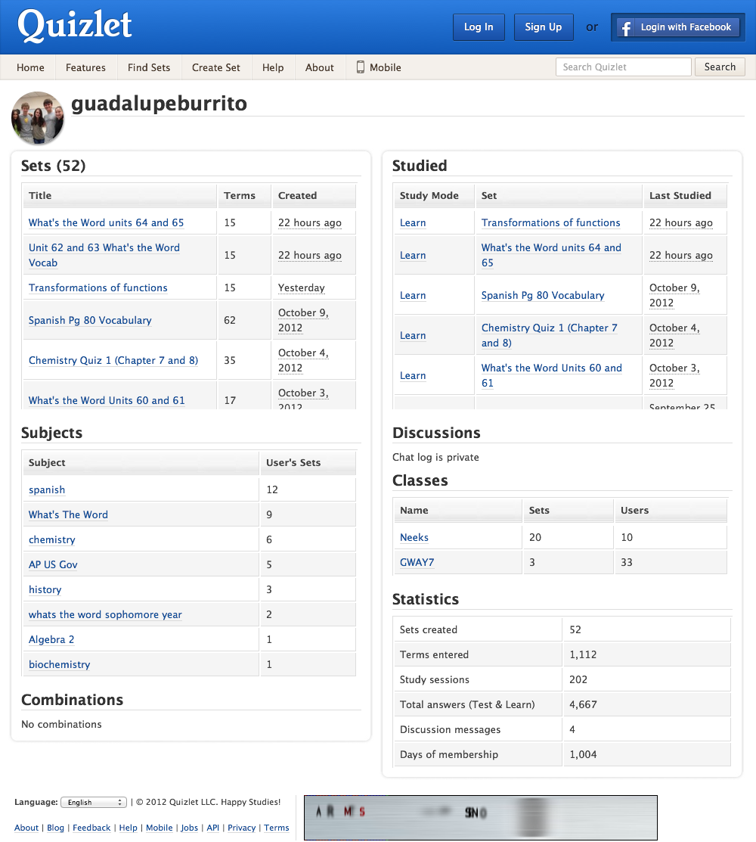

Slide 19
Wikipedia
Consistently in the top 5 most-accessed Internet sites, behind only Google, Facebook, YouTube, and Yahoo
Content is “open-source” – it can be edited and reproduced by anyone (crowdsourced information)
A hierarchy of volunteers enforce quality standards
Content is increasingly integrated into other software and hardware products (e.g. Kindle)
Not accepted as an academic source, but widely used at all academic levels to provide initial guidance for research and an overview of the relevant topics

Slide 20
Spark Notes
Cliff’s Notes for the Internet Generation
Content includes traditional outlines and summaries along with live action and animated videos
Focus on Literature, but other subjects as well
“Translations” of Shakespeare
Writing and grammar guides
Written by “top students or recent graduates”
Available in print and mobile formats as well

Slide 21
Skype
Dedicated communication platform
Works on a variety of devices
Primary uses:
Instant messaging
Longer, ongoing text conversations
Collaborative group conversations
Video conferencing
Some students will keep Skype open at all times
Serves multiple functions, socially and academically

Slide 22
Google Apps
Multitude of uses beyond search engines
Robust, free e-mail
Multi-platform Calendar
Google Docs allows free content creation and collaboration
Blogger - easy creation of web content
YouTube
RSS Reader
Google+ - social networking

Slide 23
Multimedia Content Providers
Major Providers:
Hulu
Netflix
YouTube
Vudu
Serialized, network programming is still popular, but is not the only kind of video entertainment students follow – and it is rarely watched on a television
Podcasts, short films, and a variety of sub-genres introduced by YouTube are all popular
Music likewise is almost exclusively distributed online
“Radio” stations are actually crowdsourced aggregators

Slide 24
Khan Academy
A mixture of traditional pedagogy with interactive methodologies and modern game achievements
Students can watch videos for instruction, and then complete a wide variety of structured exercises that adapt to their abilities
Progress, variety, and persistence are all rewarded with an enormous range of “achievements” that are incremented like those in a computer or console game
Emphasis on math and science, but significant content for the humanities as well

Slide 25
Khan Academy

Slide 26
Playing Games
“We must play the game of learning, not the game of school.” – Elliott Galloway
Electronic entertainment serves two functions:
Telling a story
Solving problems (either alone or collaboratively)
Most modern games, with budgets and revenues larger than blockbuster movies, offer complex challenges in sophisticated environments with astonishing detail
Games reward progress at carefully-calculated increments to encourage further play

Slide 27
A Student in His Classroom

Slide 28
A Video-Game Curriculum
Typing – It’s still the primary way to communicate
Internet Research – Guides, forums, and hints
Math – Statistics figure prominently in many games
Economics – Many games have dynamic economies
Resource Management – Essential in most games
Cognitive Mapping – Fundamental skill for gaming
History and Politics – In Strategy and Combat games
Teamwork – Many games are collaborative
Storytelling – Interactive – unlike movies, books, TV

Slide 29
Additional Resources
galloway.villines.com
for additional resources including links to all of the content providers mentioned here, detailed resources on those content providers
and an extensive bibliography on pedagogy and gaming.

